Slide 1

State of the cyber insurance marketplace
Producer Name | Date

Slide 2
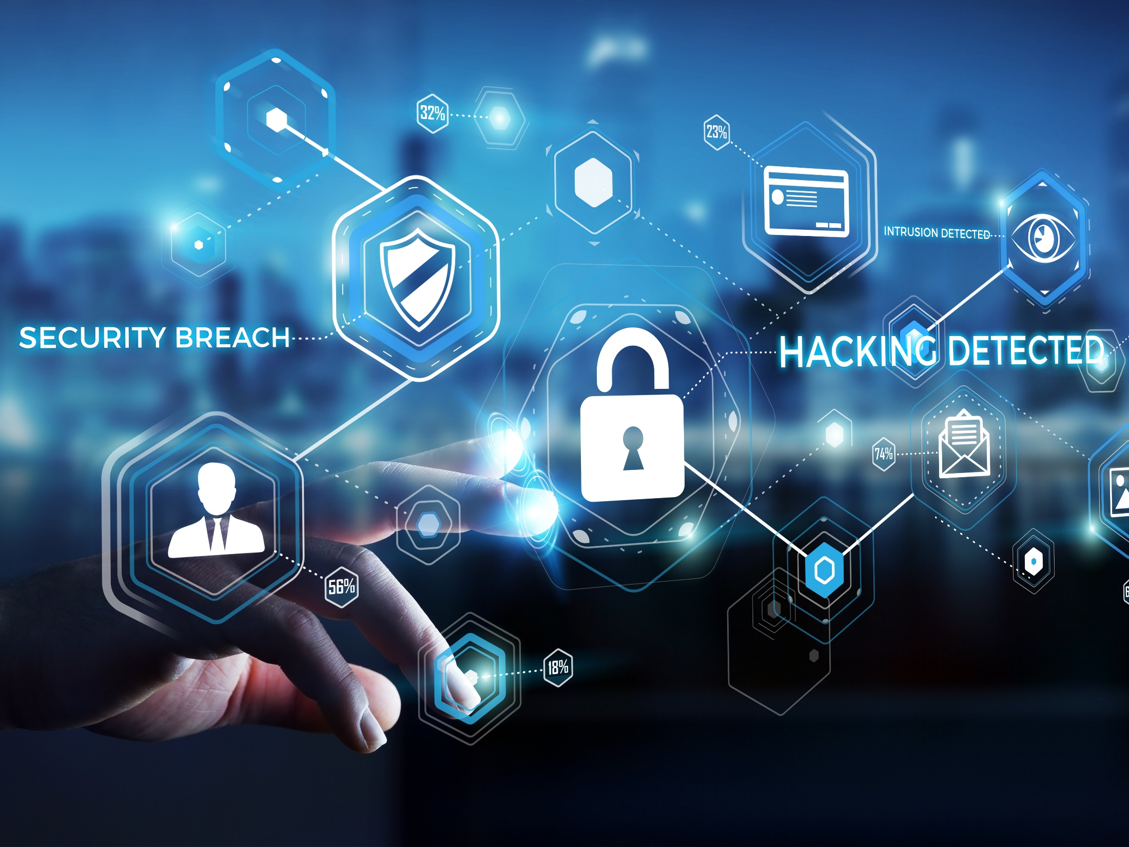
The evolution of cyber insurance

Slide 3





The Evolution of Cyber Insurance
Welcome to the Teenage Years
Pre 2013
Infant
2013 – 2018
Toddler
Teenager
2021
Pre-teen
Emergence of many new entrants from tech E&O world
Designed to cover loss affecting the insured’s network only
Security breach/hack was the sole trigger
Still relatively expensive
Focus =“data breach”
Media: limited, specific to insured’s website
Business interruption
Crime – not included
Unbridled energy
Irrational behavior
2019 – 2020
Tons of capacity
Rush to coverage innovations
The move from “data breach” to “privacy breach”
Expanded Media to include social media and off-line
Broadening triggers for Business Income
Significant expansion of “cybercrime
Lower filed rates
The start of risk management offerings
Social Engineering, FTF, Phishing
Many new entrants, grabbing market share
Filed rate reductions by many admitted markets
Losses increase significantly:
Further expansion of state privacy laws (ie: CCPA in 2020)
Emergence of more insurtechs
Ransomware
Social Engineering
Business Email Compromise
More national headline breaches
Oops – did markets reduce rates and ease underwriting requirements too soon?
The birth of a new coverage
Confusion – wanting to be like the other, more profitable lines, just not sure how to get there
Problems have become much more expensive
New rules needed to establish boundaries (MFA, RDP Config, Endpoint protection, backups, etc.)
Parents (underwriters) asking more questions, establishing curfews
Limited capacity (“Your allowance used to be $10, now it’s $2)
Some kids leaving the neighborhood (Amlin, ArgoPro)
The real fun is just getting started!
Download: The Evolution of The Cyber Insurance Market ©2021 Risk Placement Services, Inc.

Slide 4
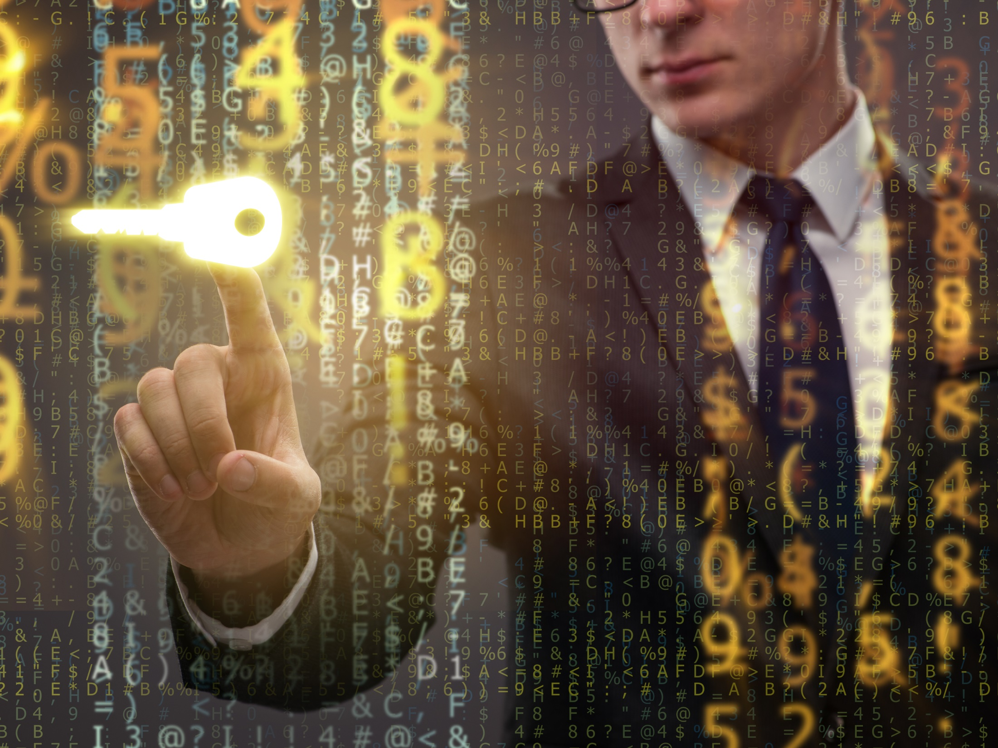
What are we seeing?
Q1 2021

Slide 5
Q1 2021: What Are We Seeing?
Significant premium increases 20-60% or more
Carrier efforts to recover from losses primarily driven by ransomware claims:
  Sub-limits or Cyber Extortion exclusions
  Higher retentions
  Co-insurance
  Reduced capacity
  Expansion of underwriting requirements (Ransomware supplemental apps, scans)
  Reduction in broker compensation

Slide 6
Q1 2021: What Are We Seeing?
Increased carrier concern over systemic/aggregate risk (ie: SolarWinds)
Carriers more willing to walk away from opportunities they don’t find profitable
Hardest hit industries:
  Public entity/govt/edu
  Manufacturing
  Construction
  Healthcare
Carriers exiting the cyber insurance space

Slide 7
Q1 2021: What Are We Seeing?
Further regulatory intervention
  NYDFS Guidance 2/4/21: Cyber Insurers Doing Business in NY Must Implement a Cyber Insurance Risk Framework:
    Establish a formal cyber insurance risk strategy
    Manage and eliminate exposure to silent cyber insurance risk
    Evaluate systemic risk
    Rigorously measure insured risk
    Educate insureds and insurance producers
    Obtain cybersecurity expertise
    Require notice to law enforcement
    Source: Insurance Circular Letter No. 2 (2021): Cyber Insurance Risk Framework | Department of Financial Services (ny.gov)
  October, 2020 Advisory on Potential Sanctions Risks for Facilitating Ransomware Payments – U.S. Department of the Treasury.

Slide 8
How did we get here?

Slide 9
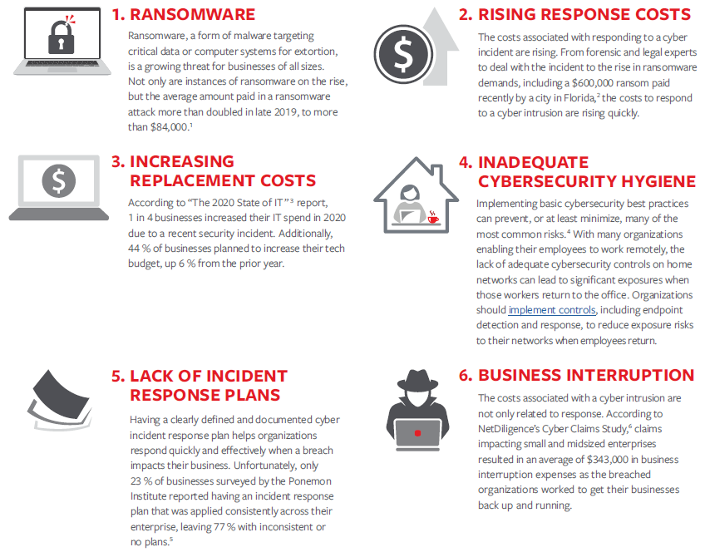
How Did We Get Here?
Source: Travelers
1 Average Cost To Recover From Ransomware Skyrockets To Over $84,000 (forbes.com)
2 Florida City Agrees To Astonishing $600,000 Ransom Payout (Updated) (forbes.com)
3 The 2021 State of IT (swzd.com)
4 How to Implement & Assess Your Cyber Hygiene (cisecurity.org)
5 Ponemon Institute’s The Fourth Annual Study on the Cyber Resilient Organization, page 35
6 NetDiligence Cyber Claims Study, 2019 Report

Slide 10
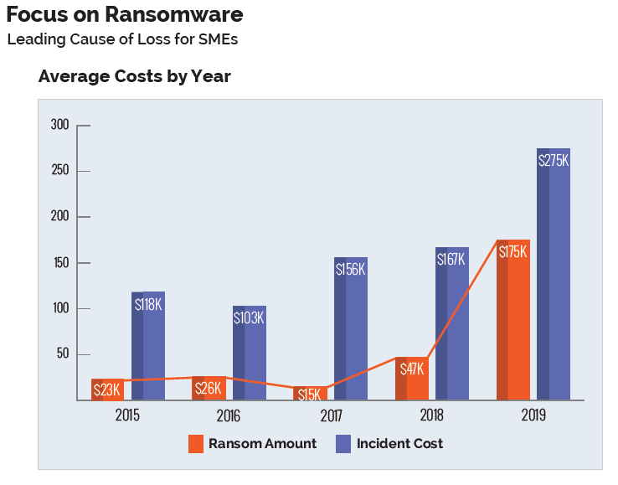
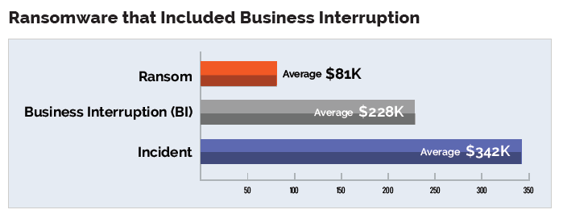
How Did We Get Here?
Source: NetDiligence Cyber Claims Study 2020 Report
1 Average Cost To Recover From Ransomware Skyrockets To Over $84,000 (forbes.com)
2 Florida City Agrees To Astonishing $600,000 Ransom Payout (Updated) (forbes.com)
3 The 2021 State of IT (swzd.com)
4 How to Implement & Assess Your Cyber Hygiene (cisecurity.org)
5 Ponemon Institute’s The Fourth Annual Study on the Cyber Resilient Organization, page 35
6 NetDiligence Cyber Claims Study, 2019 Report

Slide 11
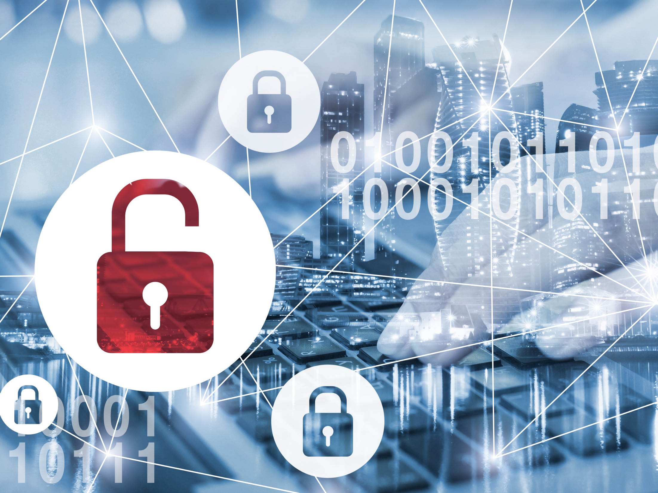
Helping you help your insureds
Navigating this new frontier requires teamwork

Slide 12
Q1 2021: How Can Insurance Agents Prepare Their Clients?
Having these efforts in place will make insureds more desirable to the insurance marketplace
Plan early for the renewal
Expect the need to provide more information than in the past
It is no longer a buyer’s market – insurers are not beholden to a timeline for indications that are 3-months or more from renewal date
Expect significant premium increases – communicate this early
Tell your insured they may need to participate in an underwriting call
Expect to have scanning technologies play into the underwriting process
Learn the basics of a ransomware supplemental application (see next slides)

Slide 13
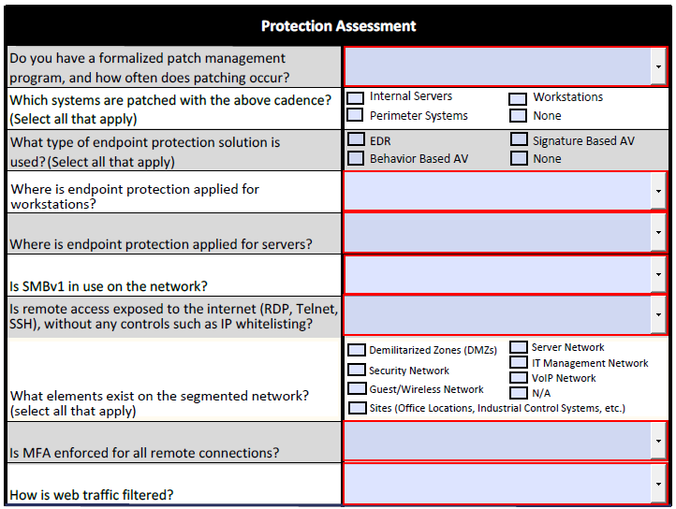
Sample Ransomware Supplemental Application

Slide 14
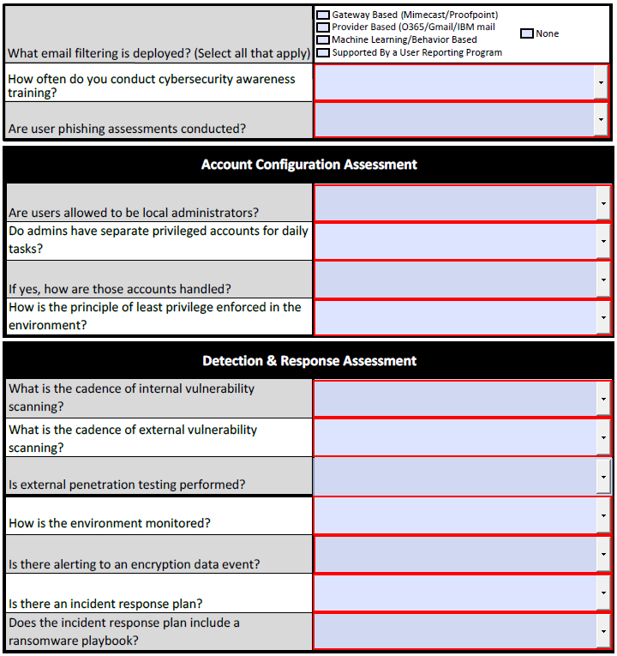
Sample Ransomware Supplemental Application

Slide 15
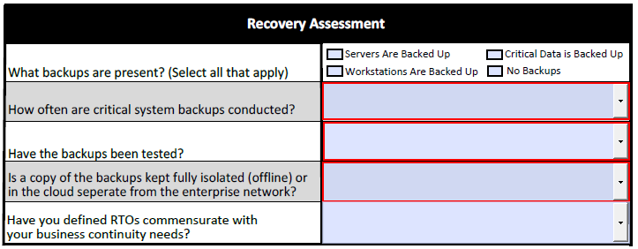
Sample Ransomware Supplemental Application

Slide 16
Q1 2021: How Can Insured’s Prepare For Their Cyber Insurance Renewal?
Having these efforts in place will make insureds more desirable to the insurance marketplace
Have a plan for managing information risk that includes ransomware recovery
Implementation of Multi-Factor Authentication (MFA)
Properly configure Remote Desktop Protocols (RDP)
Deployment of advanced endpoint protection or EDR
Ongoing employee training in InfoSec best practices
Phishing simulation campaigns
Software patch management
3-2-1 data back-up strategy
  3 copies; 2 local, but on different mediums; 1 off-site
  Segregated from the primary network
  Encrypted and tested regularly
Notes:
NOTE: When in Slide Show mode, click on a green question-mark box to see definition of each term. On the definition page, click “Go Back” home button to return to this page.

Slide 17
How we can help

Slide 18
How Can RPS Help?
Large, national Executive Lines Team > 100 strong, leveraging > $100M in written stand-alone cyber premium
  Securing best pricing and terms available
  Providing claims advocacy
Exclusive access to RPSSmallBusiness.com
  Quote/Bind/Issue 3 admitted cyber markets – 4 questions
Exclusive products, only available from RPS

Slide 19
How Can RPS Help?
Proprietary technology for coverage comparisons – RPS CyberCLICK^{sm}
Broad market reach:
  Admitted, surplus lines, domestic, international, insurtechs
Creative approach to mid-size and large cyber risk
  Multi-layer towers
  Homogeneous programs
RPS becomes an extension of your team, helping you navigate these changing times

Slide 20
Thank you!
RPS Presenter Name
RPS Presenter Phone
RPS Presenter Email
The information contained herein is offered as insurance industry guidance and provided as an overview of current market risks and available coverages and is intended for discussion purposes only. This publication is not intended to offer legal advice or client-specific risk management advice. Any description of insurance coverages is not meant to interpret specific coverages that a company may already have in place or that may be generally available. General insurance descriptions contained herein do not include complete insurance policy definitions, terms, and/or conditions, and should not be relied on for coverage interpretation. Actual insurance policies must always be consulted for full coverage details and analysis.
© 2021 Risk Placement Services, Inc.

Slide 21
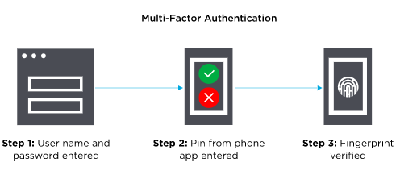
Multi-Factor Authentication (MFA)
Multi-Factor Authentication (MFA) is an authentication method that requires the user to provide two or more verification factors to gain access to a resources such as an application, online account, or a VPN.
Based on three types of additional information:
  Things you know (knowledge), such as a password or PIN
  Things you have (possession), such as a badge or phone
  Things you are (inherence), such as a biometric like fingerprints or voice recognition
Go Back
Source: Onelogin
https://www.onelogin.com/learn/what-is-mfa#:~:text=Most%20MFA%20authentication%20methodology%20is%20based%20on%20one,as%20a%20biometric%20like%20fingerprints%20or%20voice%20recognition
Notes:
NOTE: When in Slide Show mode, click the “Go Back” home button to return to Slide 13.

Slide 22
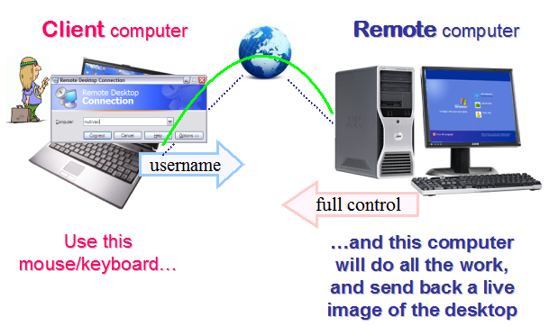
Remote Desktop Protocols (RDP)
A proprietary protocol developed by Microsoft, which provides a user with a graphical interface to connect to another computer over a network connection.
Not all “open” RDP ports are bad. Some are necessary to perform certain business functions. Others have been identified as open doors, used by various hacking groups. Insurers are increasingly scanning for the open “bad” ports, alerting insureds that they need to be closed to reduce the risk of network exploitation/ransomware attacks.
Go Back
Source: www.speedmypcupfree.com
https://www.speedupmypcfree.com/wp-content/uploads/2013/12/remote-desktop-protocol.png
Notes:
NOTE: When in Slide Show mode, click the “Go Back” home button to return to Slide 13.

Slide 23
Advanced Endpoint Protection
Also known as Endpoint Detection and Response (EDR) or Endpoint Threat Detection
EDR is a category of tools and technology used for protecting computer hardware devices–called endpoints – from potential threats. EDR platforms are made from tools that focus on detecting possible malicious endpoint activities, commonly through employing continuous monitoring.
Capabilities of most EDR Solutions:
  The unification of endpoint data.
  Increased visibility throughout a whole IT environment.
  The ability to monitor endpoints, either online or offline.
  The ability to detect malware and store endpoint events.
  The ability to respond to an event in real-time.
  Integration with additional security tools.
  The use of blacklists and whitelists.
Go Back
Source: TechTarget SearchSecurity
https://searchsecurity.techtarget.com/definition/endpoint-detection-and-response-EDR#:~:text=Endpoint%20detection%20and%20response%20(EDR)%20is%20a%20category,malicious%20endpoint%20activities,%20commonly%20through%20employing%20continuous%20monitoring.
Notes:
NOTE: When in Slide Show mode, click the “Go Back” home button to return to Slide 13.

Slide 24
SMBv1
Server Message Block (SMB) is a protocol used primarily for sharing files, printer services, and communication between computers on a network.
SMBv1 was deprecated in 2013 and is no longer installed by default on Windows Server 2016. There are a handful of vulnerabilities that exist within SMBv1, most of which allow for remote code execution on the target host.
More often than not, SMBv1 can be completely disabled. Unless the insured has legacy systems in their environment that require SMBv1 (Windows XP) or legacy applications that rely on it, they will likely not affect anything by disabling it.
The presence of SMBv1 on a network is concerning for underwriters, as it represents an increased vulnerability to attack.
Go Back
Source: Stealthbits
https://stealthbits.com/blog/what-is-smbv1-and-why-you-should-disable-it/
Notes:
NOTE: When in Slide Show mode, click the “Go Back” home button to return to Slide 13.

